Slide 1
BOOK RECOMMENDATION SYSTEM
USING MACHINE LEARNING
ALGORITHM

Slide 2
CONTENT
01
INTRODUCTION
04
FLOW DIAGRAM
02
05
Problem Statement
& MOTIVATION
TECHNOLOGIES USED
03
06
SDLC
IMPLEMENTED RESULT

Slide 3
INTRODUCTION
In the digital age, there are many books available, making it overwhelming for readers to find books they'll enjoy.
A book recommendation system is a software application that can suggest books to users based on their reading history, preferences, and other factors.
The objective of this project is to design and implement a book recommendation system that can provide personalized recommendations to users.
The system will collect user data, such as reading history, ratings, and preferences, and use algorithms such as collaborative filtering, cosine similarity, or a hybrid approach to generate accurate and relevant recommendations.
The project will involve gathering requirements, designing the system architecture, collecting and storing book and user data, implementing algorithms, developing a user-friendly interface, and testing and debugging the system.
The system will need to be scalable and secure, with measures in place to protect user data.
The book recommendation system will be a useful tool for book lovers, providing them with a personalized and efficient way to discover new books that they'll enjoy.

Slide 4

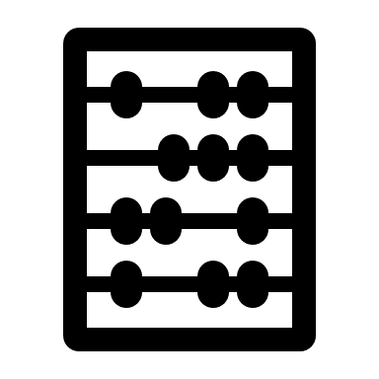
PROBLEM STATEMENT
MOTIVATION
The Motivation behind this project is to improve the reading experience of users by providing personalized recommendations based on their preferences.
This system will make reader easier to find their next book and it will also help to promote lesser-known books and authors, expanding the diversity and variety of books available to readers.
Using this system user not only save time but also provides a wider selection of books that the reader is likely to enjoy.
The Problem faced by people due to growing numbers of books available and the difficulty in finding the right book to read according to our interest.
Due to traditional method to discover new books such as bestseller lists or asking someone for recommendations can be limiting and time consuming.
The Book Recommendation System are designed to help users to discover new books based on their interests, preferences, and reading history.

Slide 5
SOFTWARE DEVELOPMENT LIFE CYCLE FOR BOOK RECOMMENDATION SYSTEM
Requirement Gather
01
Gather resources like documents, dataset etc.
Design
02
The architecture of book recommendation system
Development
03
Writing code, framework, libraries, etc
Testing
04
Testing the system to meet the requirements of user
Deployment
05
Deploy the system to production environment for user
Maintenance
06
Fix issue, add new feature, and updating

Slide 6



FLOW DIAGRAM
User Input
Collaborative filtering
Numpy & pandas
Collected dataset
Data Preprocessing of collected data
Generates
Recommended Result
Calculate
Displays the recommended Books
Checks for similar Books using algorithm
SIMILARITY B/W BOOKS USING COSINE-SIMILARITY

Slide 7
TOOLS & TECHNOLOGIES USED
01
PYTHON LANGUAGE
AND LIBRARIES
WEB DEVELOPMENT FRAMEWORK:-
FLASK
02
SOFTWARE
03
MACHINE LEARNING ALGORITHM
SCIKIT-LEARN
COLLABORATIVE FILTERING ALGORITHM
04
05
GOOGLE COLLAB FOR DATA PREPROCESSING
HTML, CSS FOR WEBSITE DESIGNING & IMPLEMENTATION
06
07
BOOK RECOMMENDATION DATASET

Slide 8
ALGORITHMS FOR BOOK RECOMMENDATION SYSTEM
ALGORITHM USED
COLLABORATIVE FILTERING
COSINE-SIMILARITY
This algorithm can be used to generate recommendation based on that books that similar users have read or rated.
It works by creating a matrix that represents the user item interaction.
Each matrix can be factorized into two smaller matrices: user and item matrix.
This algorithm can be used to calculate the similarity b/w books based on attributes such as genre, author or keywords.
It works by measuring the cosine of the angle b/w two vectors representing books.

Slide 9

IMPLEMENTED RESULT
The book recommendation system was successfully implemented, allowing users to receive personalized book recommendations based on their reading history, preferences, and other factors.
The system was able to collect user data, such as reading history, ratings, and preferences, and use algorithms such as collaborative filtering, cosine similarity, or a hybrid approach to generate accurate and relevant recommendations.
The system was able to provide users with a user-friendly interface to browse recommended books, view book details, and add books to their reading lists.
The system was able to handle a large amount of user and book data, making it scalable to accommodate growing numbers of users and books.

Slide 10
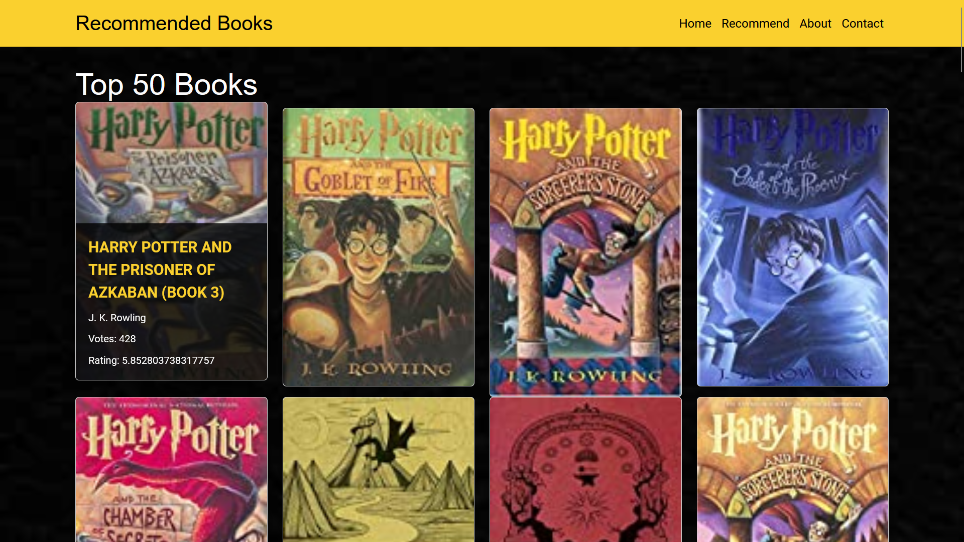

Slide 11
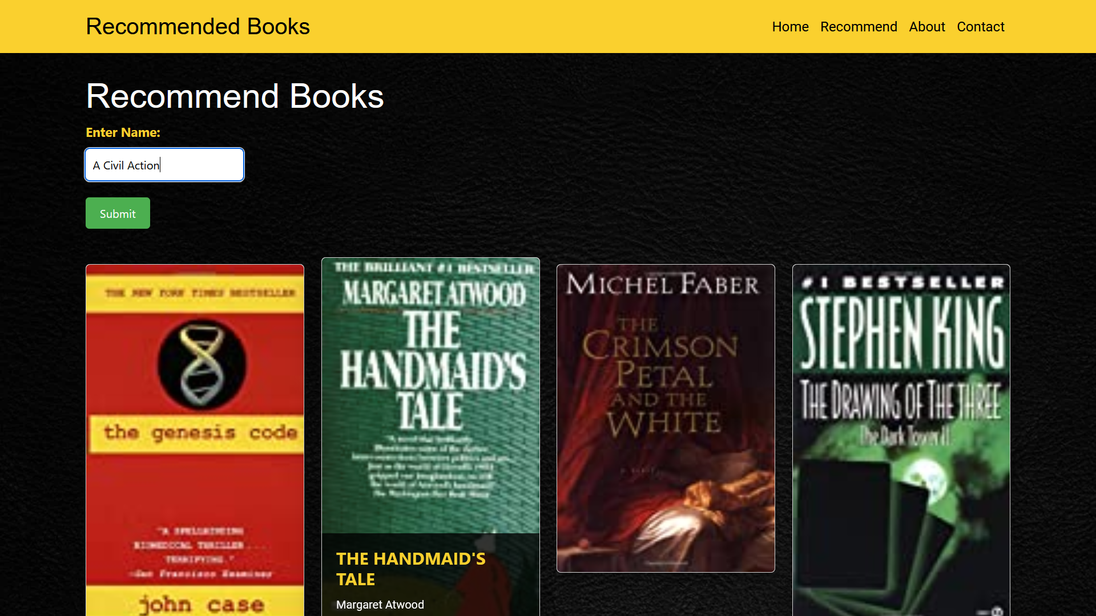

Slide 12


